Slide 1
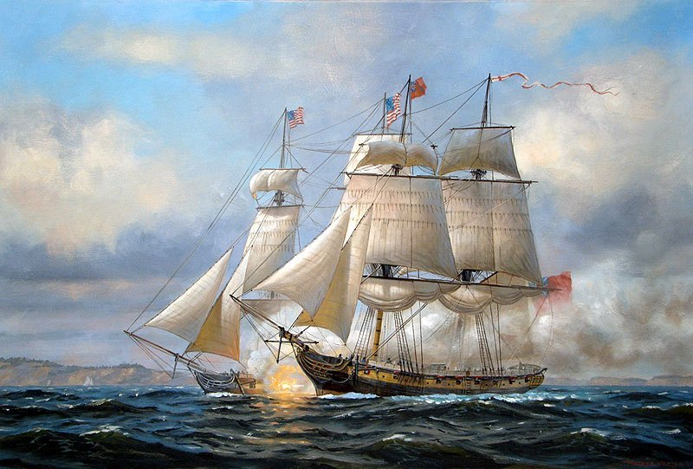
War and Expansion in the Americas
How should the War of 1812 be remembered?
LESSON 1
The Coming of War
LESSON 2
The War of 1812
LESSON 3
Settling International Issues

Slide 2
LESSON 1
The Coming of War
Big Idea
Challenges at home and abroad led the United States to declare war on Great Britain.
Main Ideas
Violations of U.S. neutrality led Congress to enact a ban on trade.
Native Americans, Great Britain, and the United States came into conflict in the West.
The War Hawks led a growing call for war with Great Britain.

Slide 3
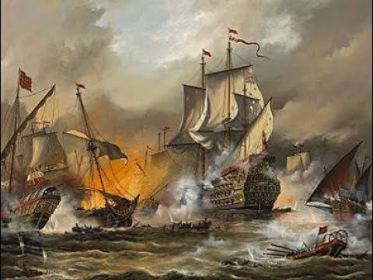
Lesson 1
Violations of Neutrality
Main Idea 1
The United States and Great Britain settled their disputes over boundaries and control of waterways.
Overseas trade was profitable but risky.
Barbary pirates, along the coast of Africa in the Mediterranean Sea, would capture ships. They would steal the cargo and hold ships’ crew for ransom.
Attacks continued until the United States sent the USS Constitution and other warships to stop the pirates.
continued…

Slide 4
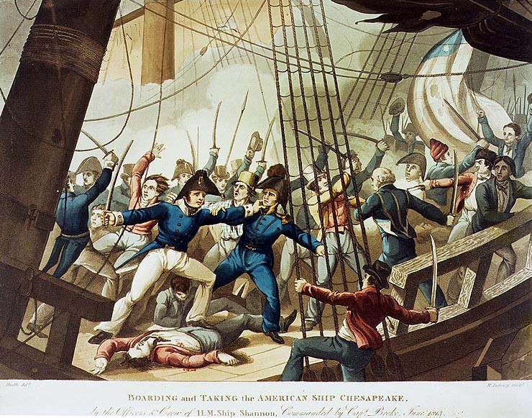
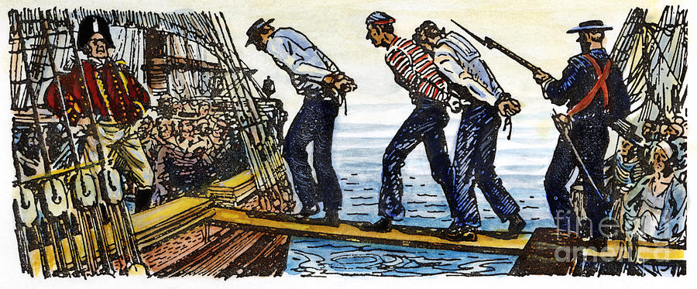
Lesson 1
Main Idea 1 - continued
Violations of Neutrality
British and French tried to stop the United States from supplying goods with the other while they were at war in 1803.
British stopped American merchant ships to search for British sailors who had run away and steal any war supplies they could get their hands on.
British sailors were forced to return. Sometimes U.S. citizens were taken by accident.
Impressment, or the practice of kidnapping and forcing people to serve in the army or navy outraged Americans.
Americans were stunned when the British ship Leopard stopped the U.S. Navy ship Chesapeake and took sailors by force.
continued…

Slide 5
Lesson 1
Main Idea 1
Non-Intercourse Act
Congress replaced unpopular Embargo Act with Non-Intercourse Act in 1809.
Banned trade only with Britain, France, and their colonies
U.S. trade would resume with the first side to stop violating American neutrality
Law was no more successful than Embargo Act
(continued)
Embargo Act
In response to Britain’s violation of U.S. neutrality, some Americans wanted war.
Others wanted an embargo, or a banning of trade against Britain.
Embargo Act passed in 1807, banning trade with all foreign countries to punish Britain and France
Devastated American merchants, who lost much money without trade
Damaged Jefferson’s popularity and strengthened Federalists
Congress hoped that the embargo would punish Britain and France and protect American merchant ships from capture.
Had little effect on Britain and France

Slide 6
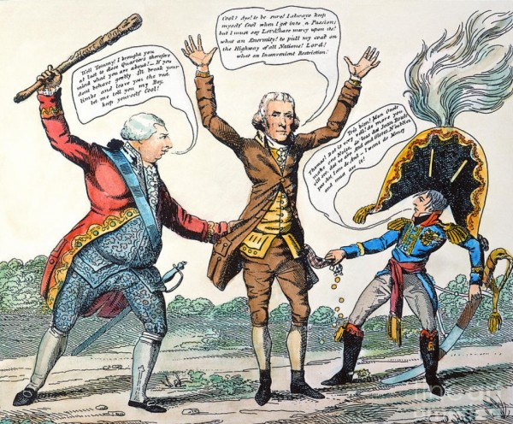

Slide 7
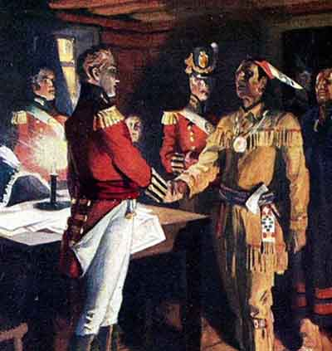
Lesson 1
Conflict in the West
Main Idea 2
Native Americans, Great Britain, and the United States came into conflict in the West.
Conflict in the West
As thousands of settlers headed west, British and Native Americans clashed with American settlers over land.
British agents from Canada armed Native Americans along western frontier.
continued…

Slide 8
Lesson 1
Main Idea 2
(continued)
Tecumseh Resists U.S. Settlers
Tecumseh, a Shawnee chief, emerged as leader. He and his brother “The Prophet” banded together to lead the Natives in the area.
He was a brilliant speaker who hoped to unite Native Americans of northwestern frontier, the South, and the eastern Mississippi Valley.
They argued that the Treaty of Greenville wasn’t valid as their tribes did not sign it.
The Battle of Tippecanoe
Tecumseh founded village (Prophetstown) near Tippecanoe and Wabash rivers in Indiana Territory.
Governor William Henry Harrison warned Tecumseh not to resist power of the United States.
Harrison led army in attack on the village in 1811 while Tecumseh was away asking for more allies.
He was worried that with British backing, Tecumseh could be a serious threat to U.S. power in the West.
U.S. forces won Battle of Tippecanoe, and Tecumseh fled to Canada.

Slide 9
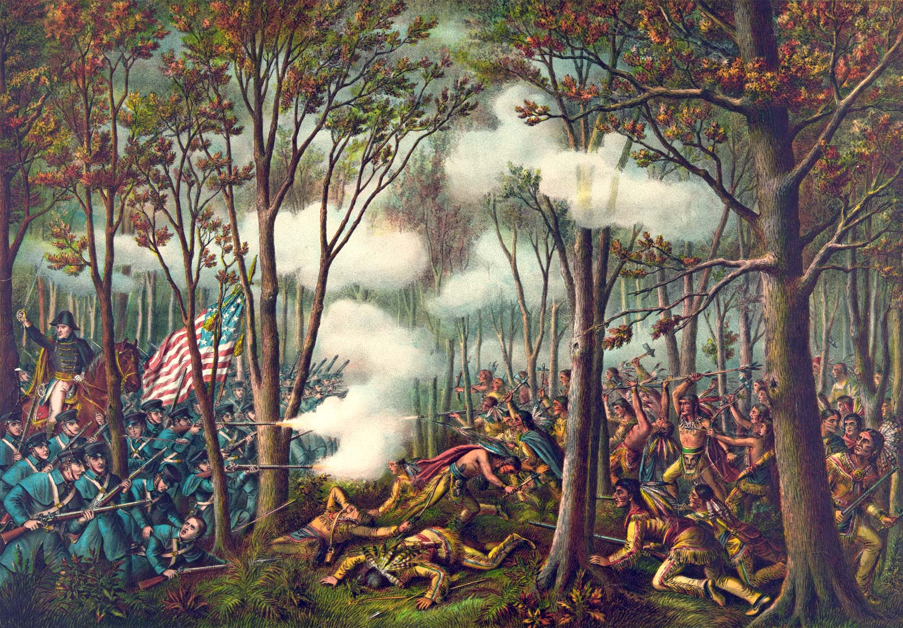

Slide 10
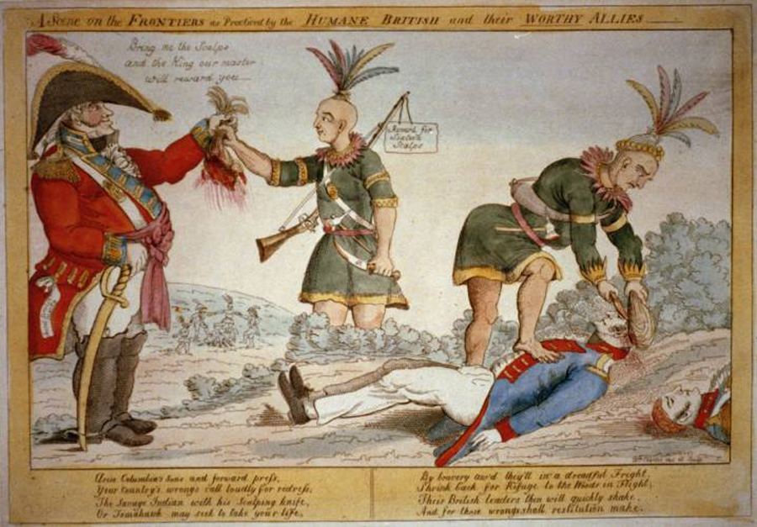
Lesson 1
Call for War
Main Idea 3
The War Hawks led a growing call for war with Great Britain.
War Hawks
Evidence of British support for Tecumseh and Native Americans inflamed Americans.
Some young members of Congress from the South and West, called War Hawks, demanded war against Britain.
They were angered by British trade restrictions
They wanted to invade Canada for more land to settle.
continued…

Slide 11
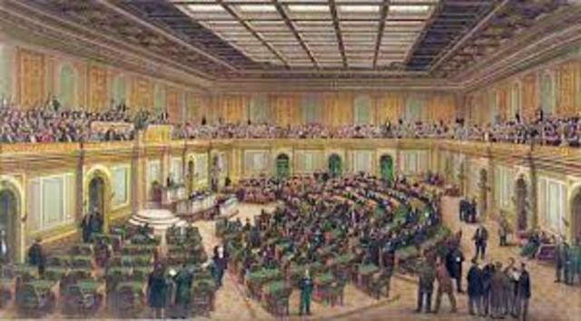
Lesson 1
Call for War
Main Idea 3 - continued
The Opposition
New England Federalists opposed war.
British trade restrictions hurt New England’s economy, they wanted to renew friendly business
Others argued that the United States was not ready to fight (weak army and navy and not enough supplies.)
continued…

Slide 12
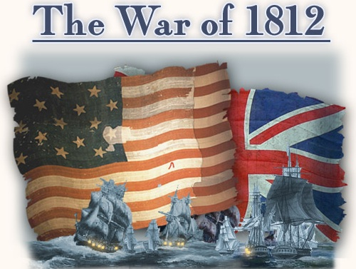
Lesson 1
Main Idea 3
(continued)
Declaring War
Republican James Madison was elected president in 1808.
Felt growing pressure from War Hawks
Decided Congress must vote on war in 1812
Congress voted, and the War Hawks won.
Congress had declared war for the first time in the nation’s history.
Madison was reelected in 1812.
Would serve as commander in chief during War of 1812

